Slide 1


Single Cycle CPU
Anthony Ramos
CSC342/43
Spring 2021

Slide 2

Objective
Design a Single Cycle (MIPS Processor) CPU that can execute MIPS instructions.

Slide 3
Objective(Cont.)
Instruction | Mnemonic | Format | Operation
Add | add | R | R[rd] = R[rs] + R[rt]
Add Immediate | addi | I | R[rt] = R[rs] + SignExtImm
Add Immediate Unsigned | addiu | I | R[rt] = R[rs] + SignExtImm
Add Unsigned | addu | R | R[rd] = R[rs] + R[rt]
Subtract | sub | R | R[rd] = R[rs] - R[rt]
Subtract Unsigned | subu | R | R[rd] = R[rs] - R[rt]
Multiply | mult | R | R[rd] = R[rs] * R[rt]
Divide | div | R | R[rd] = R[rs] / R[rt]
And | and | R | R[rd] = R[rs] & R[rt]
And Immediate | andi | I | R[rt] = R[rs] & ZeroExtImm
Nor | nor | R | R[rd] = ~(R[rs] | R[rt])
Or Immediate | ori | I | R[rt] = R[rs] | ZeroExtImm
Shift Left | sll | R | R[rd] = R[rs] << shamt
Shift Right | srl | R | R[rd] = R[rs] >> shamt
Shift Right Arithmetic | sra | R | R[rd] = R[rs] >>> shamt
Store Word | sw | I | M[R[rs]+SignExtImm] = R[rt]
Load Word | lw | I | R[rt] = M[R[rs]+SignExtImm]
Branch if Equal | beq | I | PC = PC+4+[SignExtImm,2b00] If R[rs] == R[rt]
Branch if Not Equal | bne | I | PC = PC+4+[SignExtImm,2b00] If R[rs] != R[rt]
Jump | j | J | PC += JumpAddress << 2

Slide 4
R-Type, I-Type, & J-Type Instruction Formats
32 26 21 16 11 6 0
R-Type
Opcode | Rs | Rt | Rd | Shamt | Funct
6-Bit 5-Bit 5-Bit 5-Bit 5-Bit 6-Bit
31 26 21 16 0
I-Type
Opcode | Rs | Rt | Immediate
6-Bit 5-Bit 5-Bit 16-Bit
31 26 0
J-Type
Opcode | Target Address
6-Bit 26-Bit

Slide 5
CPU Control Unit
<25:21>
<20:16>
<15:11>
<10:6>
<15:0>
<25:0>
Opcode
Funct
Instruction
<31:0>
Rs
Rt
Rd
Shamt
Immediate
Jump
Addr.
Instruction
Memory
32
Address
<31:26>
<5:0>
CPU Control Unit
Jump
Branch
RegDst
RegWr
ExtOp
ALUSrc
ALUCtrl
MemToReg
MemWr
MemRd
Data path

Slide 6
Meaning of Control Signals
Signal | Value = 0 | Value = 1
Branch | PC <= PC + 4 | PC <= PC + 4 + {SignExt(Imm), <<2}
ALUSrc | Operand 2 <= BusB | Operand 2 <= SignExt(Imm)
ExtOP | Zero extend | Sign extend
RegWr | No write | The register on the Write register input is written with the value on the Write data input
RegDst | ALUResult <= Rt | ALUResult <= Rd
MemWr | No write | Write to memory
MemtoReg | ALU | Memory
Jump | No Jump | Jump to effective address

Slide 7
Summary of ALUCtrl Signals
ALUCtrl | Operation
0000 | add/addi/addu/addiu/sw/lw
0001 | sub/subu/beq/bne
0010 | mult
0011 | div
0100 | and/andi
0101 | ori
0110 | nor
0111 | sll
1000 | srl
1001 | sra
Note: The Jump instruction does not depend on an arithmetic or bitwise operation

Slide 8
Summary of Control Signals (Datapaths)
Operation | Branch | ALUSrc | ExtOP | RegWr | RegDst | MemWr | MemRd | MemtoReg | ALUCtrl | Jump
Add | 0 | 0 | X | 1 | 1 | 0 | 0 | 0 | 0000 | 0
Addu | 0 | 0 | X | 1 | 1 | 0 | 0 | 0 | 0000 | 0
Addi | 0 | 1 | 1 | 1 | 0 | 0 | 0 | 0 | 0000 | 0
Addiu | 0 | 1 | 1 | 1 | 0 | 0 | 0 | 0 | 0000 | 0
Sub | 0 | 0 | X | 1 | 1 | 0 | 0 | 0 | 0001 | 0
Subu | 0 | 0 | X | 1 | 1 | 0 | 0 | 0 | 0001 | 0
Mul | 0 | 0 | X | 1 | 1 | 0 | 0 | 0 | 0010 | 0
Div | 0 | 0 | X | 1 | 1 | 0 | 0 | 0 | 0011 | 0
And | 0 | 0 | X | 1 | 1 | 0 | 0 | 0 | 0100 | 0
Andi | 0 | 1 | 0 | 1 | 0 | 0 | 0 | 0 | 0100 | 0
Ori | 0 | 1 | 0 | 1 | 0 | 0 | 0 | 0 | 0101 | 0
Nor | 0 | 0 | X | 1 | 1 | 0 | 0 | 0 | 0110 | 0
Sll | 0 | 0 | X | 1 | 1 | 0 | 0 | 0 | 0111 | 0
Srl | 0 | 0 | X | 1 | 1 | 0 | 0 | 0 | 1000 | 0
Sra | 0 | 0 | X | 1 | 1 | 0 | 0 | 0 | 1001 | 0
Lw | 0 | 1 | 1 | 1 | 0 | 0 | 1 | 1 | 0000 | 0
Sw | 0 | 1 | 1 | 0 | X | 1 | 0 | X | 0000 | 0
BEQ | 1 | 0 | 1 | 0 | X | 0 | 0 | X | 0001 | 0
BNE | 1 | 0 | 1 | 0 | X | 0 | 0 | X | 0001 | 0
Jump | 0 | X | X | 0 | X | 0 | 0 | X | XXXX | 1

Slide 9
Summary of R-Type Function Fields
R-Type Instruction | Funct Field
add | 100000
addu | 100001
sub | 100010
subu | 100011
mul | 011000
div | 011010
and | 100100
nor | 100111
sll | 000000
srl | 000010
sra | 000011
Note: The Opcode field for all R-Type instructions are 0x000000

Slide 10
Summary of I&J-Type Opcode Fields
Instruction | Opcode
addi | 001000
addiu | 001001
andi | 001100
ori | 001101
lw | 100011
sw | 101011
beq | 000100
bne | 000101
j | 000010
Note: The Funct field value does not matter!

Slide 11
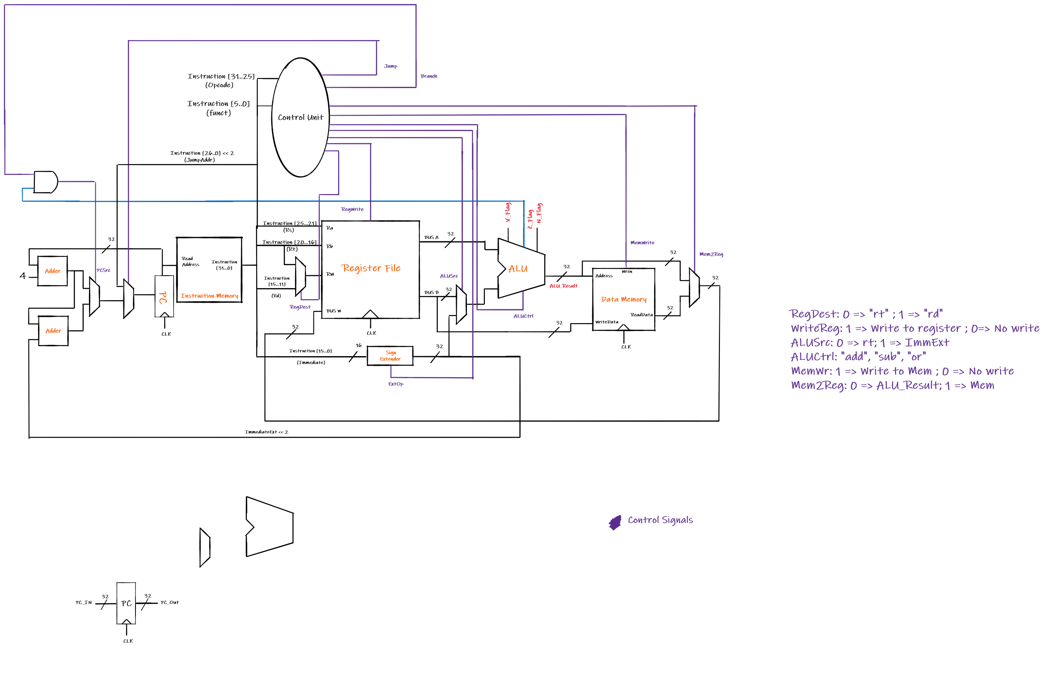
Putting it all together
Notes:
Hand drawn Single Cycle CPU design

Slide 12
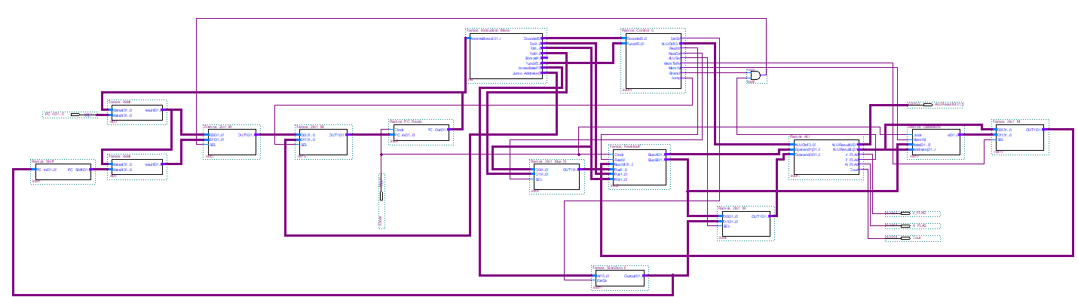
Single Cycle CPU Design I
Notes:
Quartus Implemented Design

Slide 13
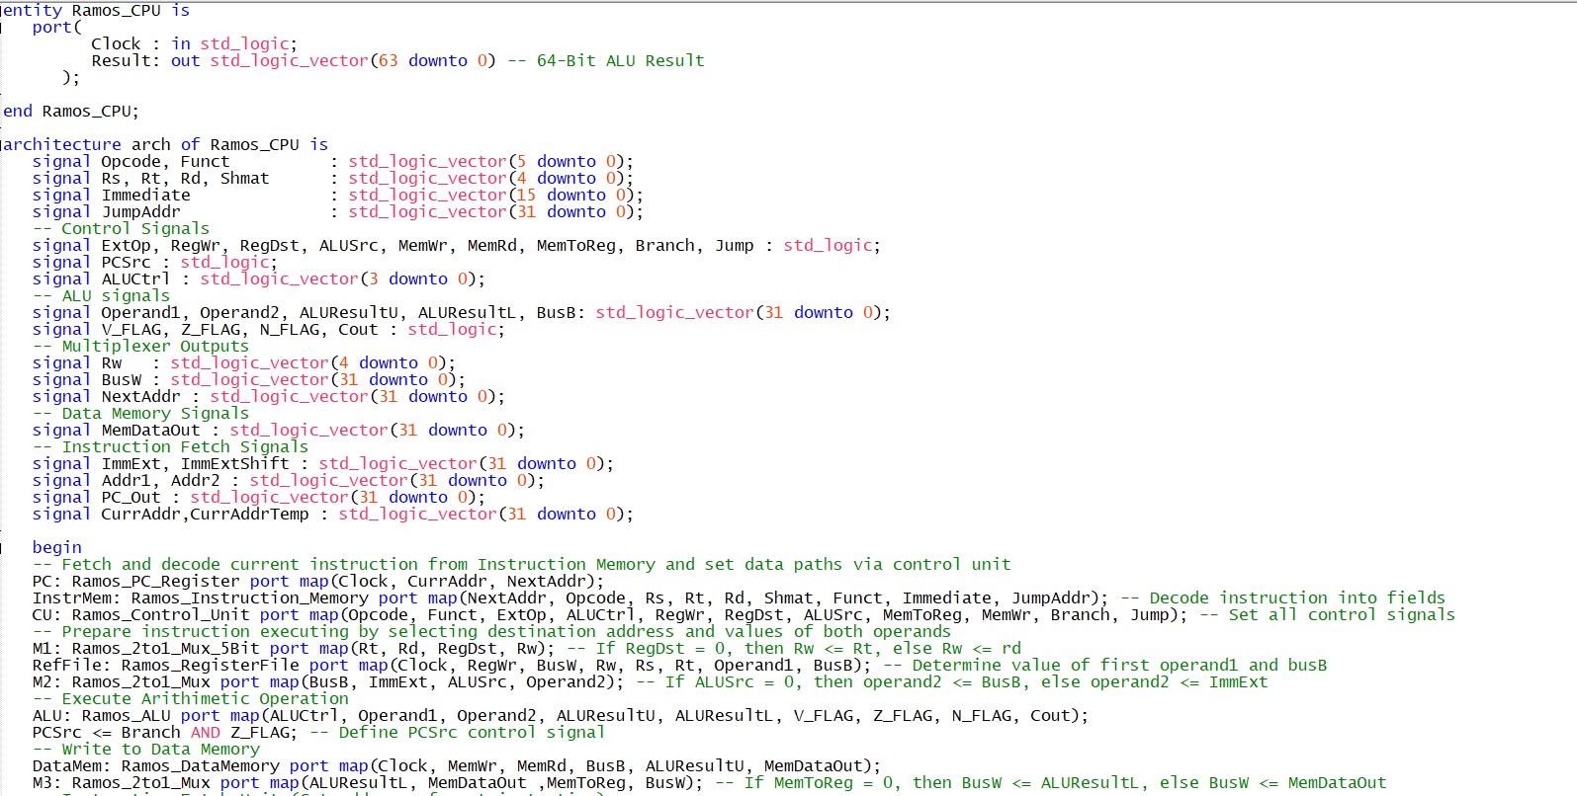
Notes:
Quartus Implemented Design

Slide 14
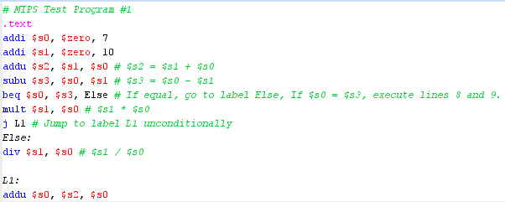
Test – Basic Arithmetic & Conditionals
See report for pitfalls and testing of bitwise operations

Slide 15
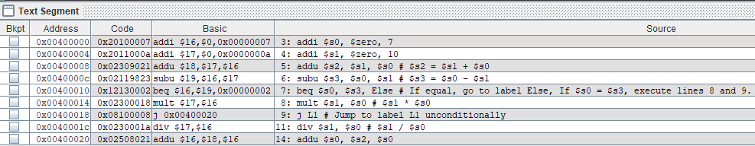
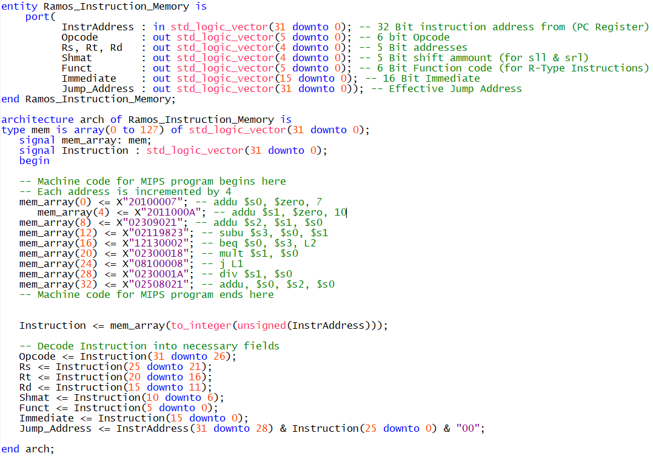
Test – Basic Arithmetic & Conditionals

Slide 16
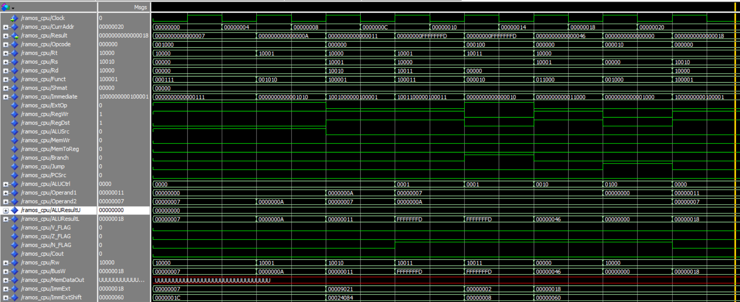
addi $s0, $zero, 7
addi $s0, $zero, 10
addu $s2, $s1, $s0
subu $s3, $s0, $s1
beq $s0, $s3
mult $s1, $s0
J L1
addu $s0, $s2, $s1

Slide 17
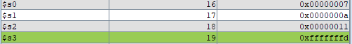
Register values after the execution of instructions 0x20100007 to 0x12130002
Register values after the execution of instructions 0x02300018 (i.e., mult $s1, $s0)
Register values after the execution of final instruction (i.e., addu $s0, $s2, $s1)

Slide 18
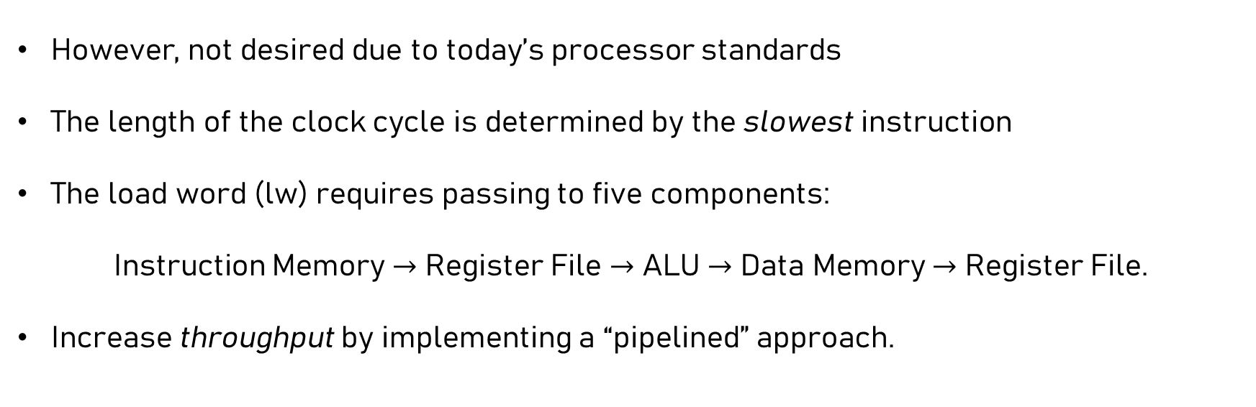
Conclusion
However, not desired due to today’s processor standards
The length of the clock cycle is determined by the slowest instruction
The load word (lw) requires passing to five components:
Instruction Memory $→$ Register File $→$ ALU $→$ Data Memory $→$ Register File.
Increase throughput by implementing a “pipelined” approach.

